Slide 1
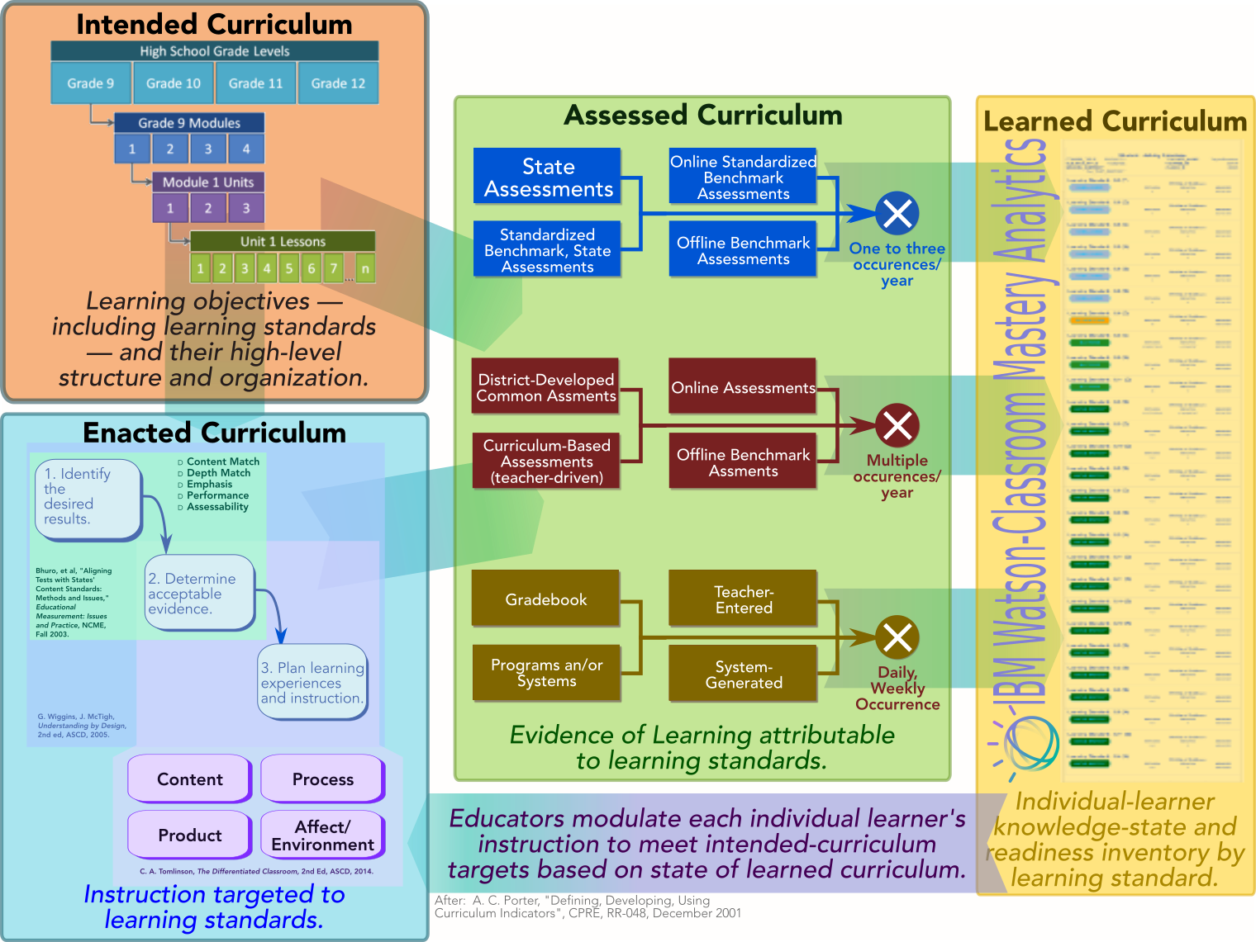
The education theory on which Watson-Education Mastery is based depends on an aligned, digitized curriculum.
Standards-aligned evidence of learning.
Policies, preferences for imputing learners’ state of knowledge based on proficiency measurements
What the Mastery algorithm produces.
Learning-standards baseline.
Learning-standards progressions.
Course blueprints/curriculum maps.
Learning-standards version migration.
Teacher units.
Course enrollment.
Course-section teaching assignments.
Instructional content aligned to intended curriculum.
Instructional guides, lesson plans, formative-assessment examples.

Slide 2
The Mastery-Adoption flow establishes prospective clients’ state of curriculum maturity en route to its operationalization.
Mastery-Adoption Stage |  | Objectives and Outcomes
⓪ | Curriculum-digitization and -alignment workshop survey. | Qualitative assessment of the degrees of alignment and digitization of prospective clients’ curriculum and assessments. Adoption-readiness recommendation based on template-driven maturity model. Recommended roadmap to digitize, improve alignment of curriculum and assessments.
① | Curriculum-alignment indicators analysis for digital curriculum. | Quantitative “logical” indicators of extent of alignment of digitized curriculum and assessments based on actual client data. Detailed project plan — proposal-quality BoE — to fully operationalize Watson-Education Mastery.
② | Reusable logic to transform unprecedented standards-aligned evidence of learning into Watson-Compatible format. | Development, operationalization of data-transformation logic, interface to submit standards-aligned evidence of learning from unprecedented source (e.g., third-party system IBM hasn’t seen before).
③ | Operational initialization of Watson-Education Mastery. | Full operationalization of Watson-education Mastery.
④ | Watson-Mastery Growth Model. | Overlay growth model — time-rate of individual-student proficiency advancement — onto Watson-Education Mastery foundation.
⑤ | Watson-Mastery Advanced Curriculum-Alignment Indicators. | Provide advanced education-research-based indicators (e.g., Porter, http://ibm.biz/PorterCurriculumAlignment) of school districts’ extent curriculum alignment.
⋮ | ⋮ | ⋮

Slide 3
Phase ⓪: Client-qualification review ascertains state of client maturity, readiness to adopt Watson-Education Mastery.
Objectives: | Introduced Watson-Education framework for curriculum digitization and alignment, prerequisite for scalable competency-based differentiated instruction, personalized learning.
 | Learning standards and progressions; Intended curriculum (course blueprints, curriculum maps, etc); Enrolled students and teacher assignments; | Standards-aligned evidence of learning; and Consistent criteria for associating evidentiary observations with proficiency/mastery states.
 | Perform qualitative, template-driven alignment analysis based on readily-available curriculum, assessment artifact. Provide readiness assessment using staged maturity model.
Approach: | Begin with template capturing curriculum scope (subject × grade level × campus). Review exemplary curriculum artifacts based on alignment, digitization criteria. Curriculum maps, course blueprints, scope & sequence, etc. Instructional guides, rubrics, formative-assessment examples and guidelines. Interim/summative assessments. Apply rubrics/heuristics to associate distinct grades, subjects with maturity-model stages. Synopsize results. Sketch out roadmap to advance state of curriculum digitization, alignment.
𝓠𝓾𝓮𝓼𝓽𝓲𝓸𝓷: | Partnership, cross-sell opportunities?

Slide 4
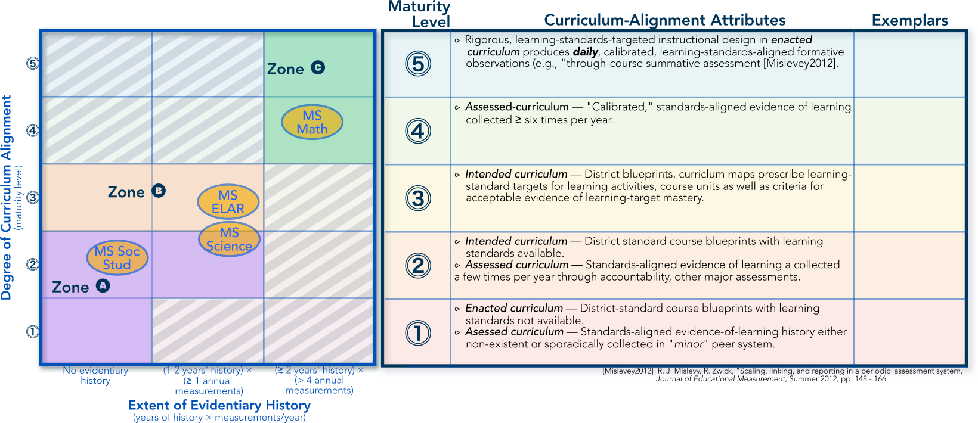
Phase ⓪ client-qualification analysis employs a template-driven maturity-model framework to characterize client readiness.

Slide 5
Phase ① curriculum-alignment analysis empirically demonstrates clients’ readiness to adopt Watson-Education Mastery.
Objectives: | Engender sufficient confidence on both sides to take commit to the investment of Watson-Education Mastery implementation. Develop detailed mastery-implementation plan (proposal-quality Basis of Estimate).
Approach: | Collect actual digitized-curriculum data from client. Client digitizes “intended” curriculum (course blueprints, curriculum maps using Watson-Education Curriculum Tool. Client provides student-course enrollment data for intended scope (campus × subject × grades) of analysis. Client provides standardized-aligned evidence of learning in structured, digitized format. IBM performs curriculum-alignment analysis.
 | Blueprints ↔︎ learning-standard progressions. Evidence of learning ↔︎ course blueprints. | Evidence of learning ↔︎ learning-standards progressions. Likely evidentiary, estimation coverage.
 | Outbrief graphically depicts curriculum-alignment indicators.
Prerequisites: | Data & privacy agreement, arrangements (e.g., provision sftp server).

Slide 6
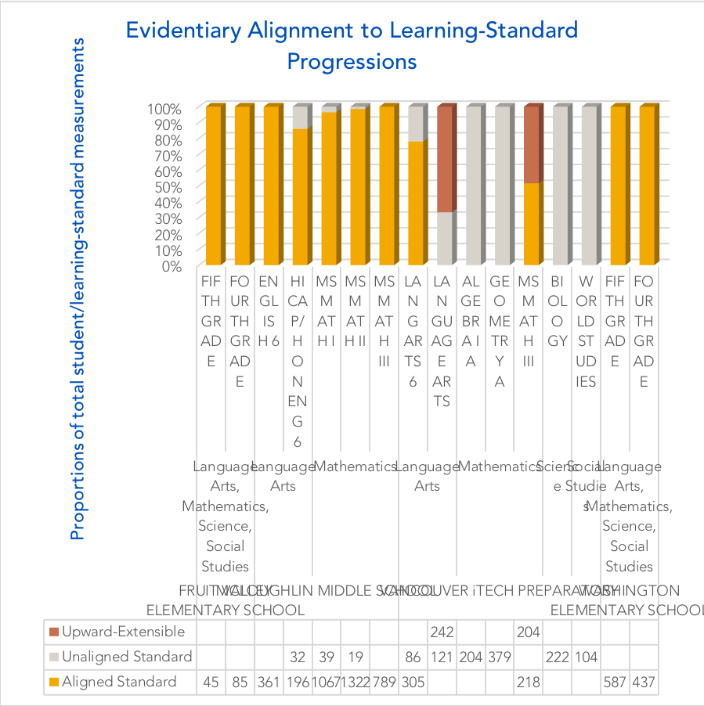
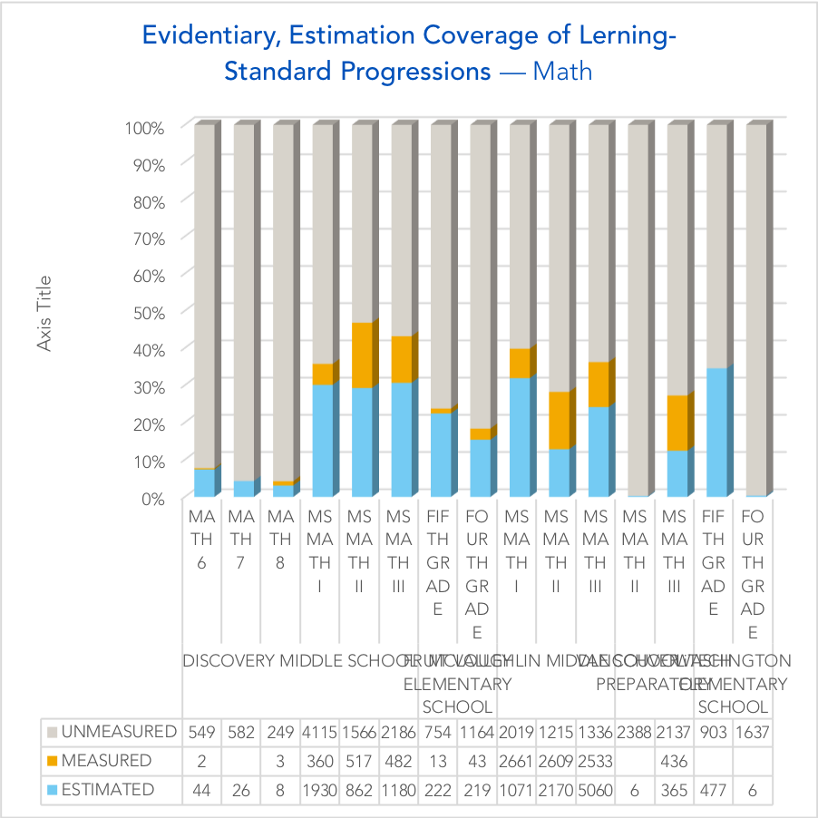
Phase ① analysis provides quantitate, evidence-based confidence on both sides of transaction to make the investment.
Alignment analysis answers questions like, “Is the system measuring what is specified by curriculum policy?”
Coverage analysis answers questions like, “Is the system covering everything our policy specifies should be covered?”

Slide 7
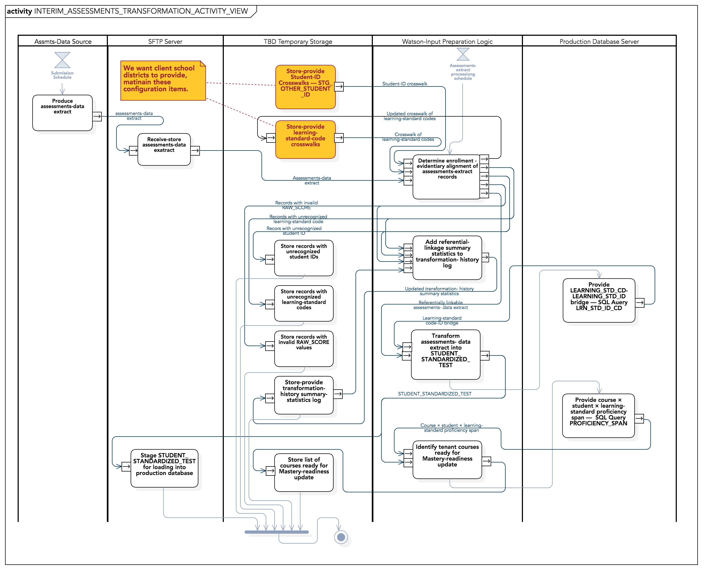
Phase ② implements interface between unprecedented (to Watson Education) third-party standards-aligned assessment system.
Illustrative

Slide 8
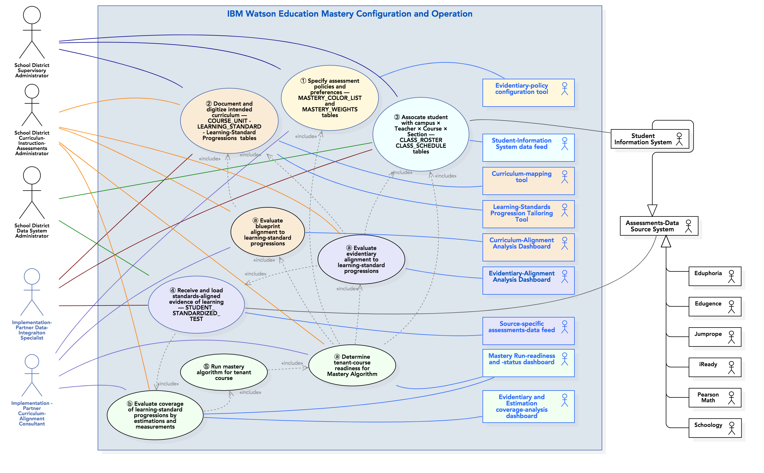
Phase ③ operationalizes Watson-Education mastery in the client’s education-technology ecosystem.

Slide 9
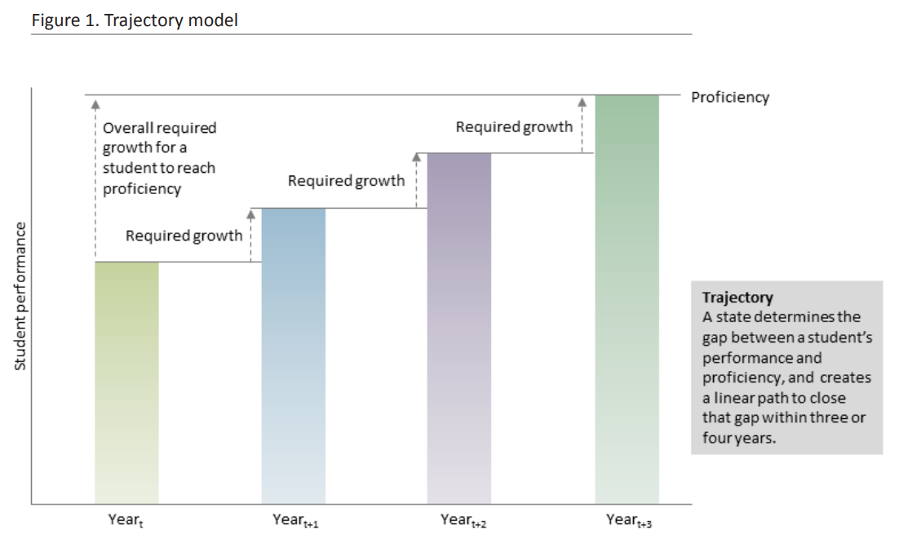
Phase ④ growth-model analysis gives educators, parents, other stakeholders a much-clearer view of individual-student progress than models based on state-accountability exams.
State-accountability exams severely under-sample “proficiency space” (http://ibm.biz/RSS-Significance-TestEfficiency).
Robustly implemented, Watson-Education Mastery collects provides relatively complete coverage.
From : “Growth models: Issues and advice from states,” U.S. Department of Education, https://nces.ed.gov/programs/slds/pdf/guide_growth-model.pdf.

Slide 10
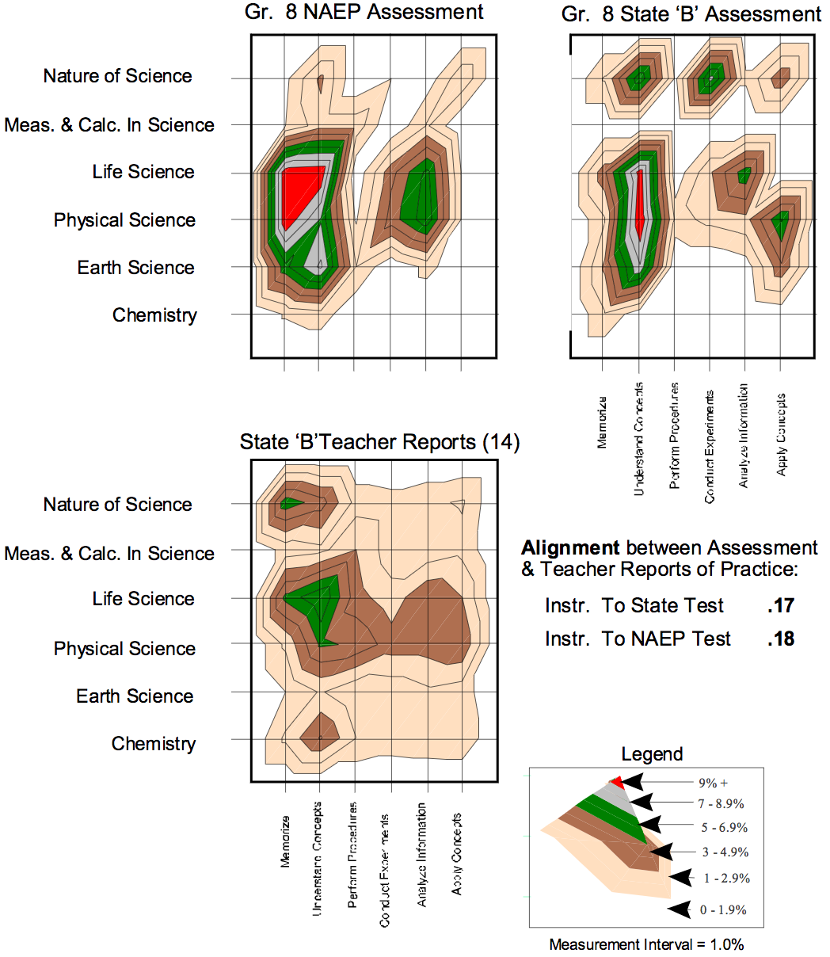
Phase ⑤ “advanced” curriculum-alignment indicators provide a sophisticated view of how what is being taught, measured addresses what is specified.
Phase ② curriculum-alignment administrators provide only a “binary” view of whether ”dots” — whether what is taught, measured addresses curriculum policy — are connected.
“Advanced” curriculum-alignment indicators provide supervisory, curriculum administrators with deeper insights into the extent to which their system uniformly provides opportunity to learn for all students.
From : A. Porter, “Defining, developing, and using curriculum indicators,” Center for Policy Research in Education (CPRE), University of Pennsylvania, December 2001, http://ibm.biz/PorterCurriculumAlignment.

